Slide 1
Biomechanical modelling of the foot (and ankle)
Ahmad Shaikh

Slide 2
In This Presentation
Introduction
Primary goals
Areas of growth
Timeline
Summary

Slide 3
Methods Used to simulate the foot
Multi-Body Dynamics
Patient Specific Finite Element Analysis
Simplified Geometry Finite Element Analysis

Slide 4
Multi-Body Dynamics
Fantastic tool…. If we all run barefoot
Can be used as inputs to FEA

Slide 5
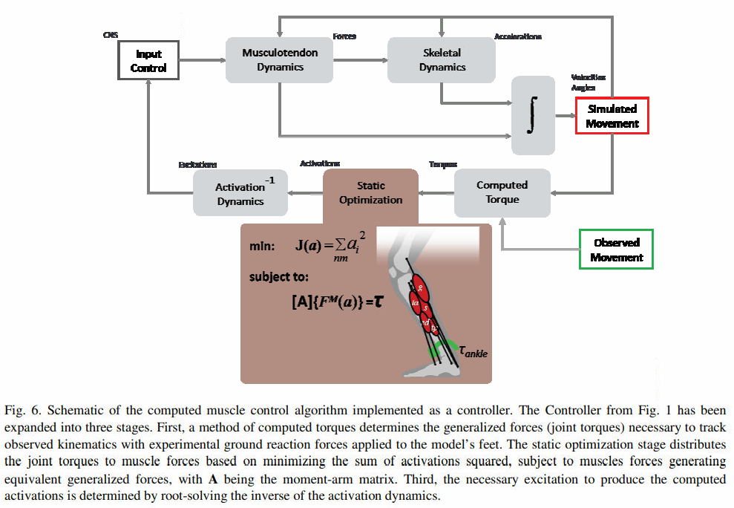
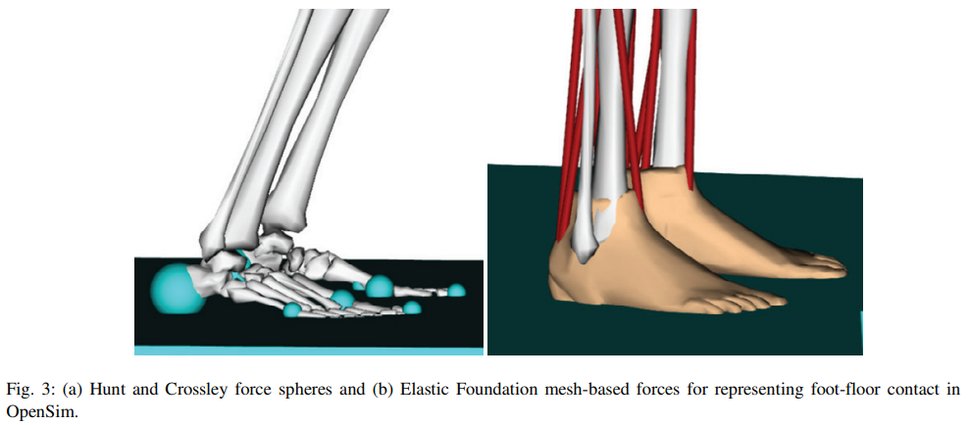
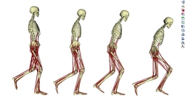
OpenSim is the most widely used Multibody Dynamics solver for human biomechanics
Bones are Rigid Bodies connected to each other by joints, ligaments and muscles
Can be used to calculate kinematics, joint angles, ground reaction forces and muscle forces
2 contact models are used - Hertz Contact Theory or Elastic Foundation Model (uses a mesh and simplifies to multiple springs)
http://dx.doi.org/10.1016/j.piutam.2011.04.021

Slide 6
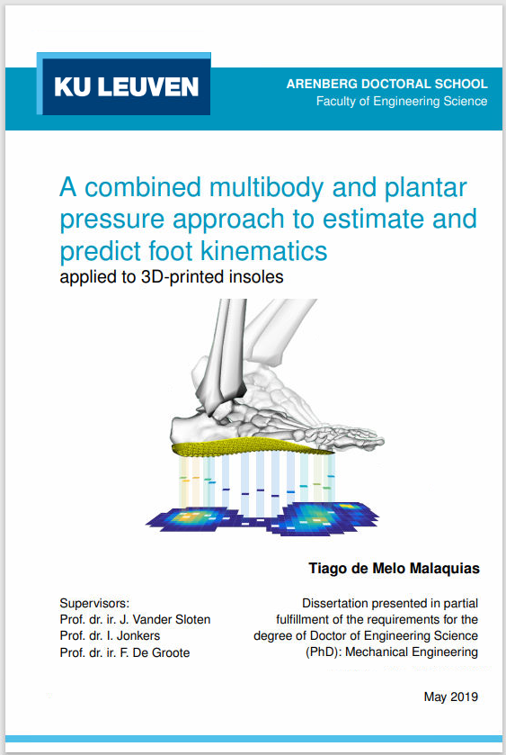
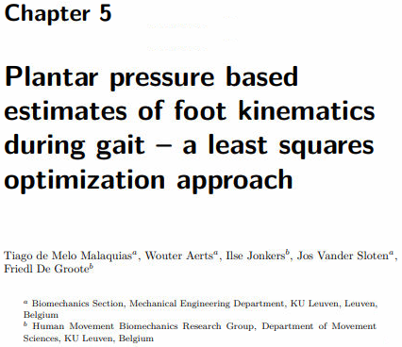

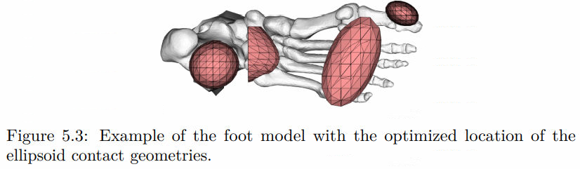
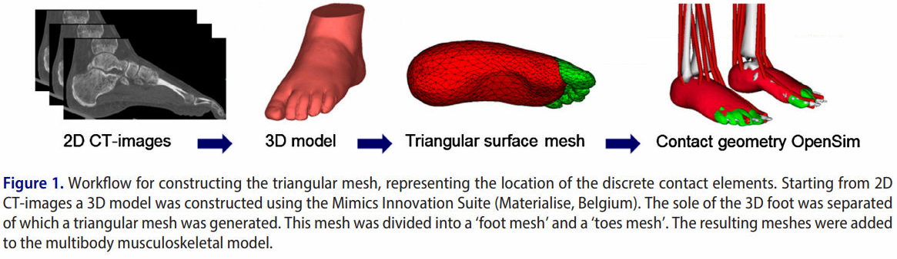
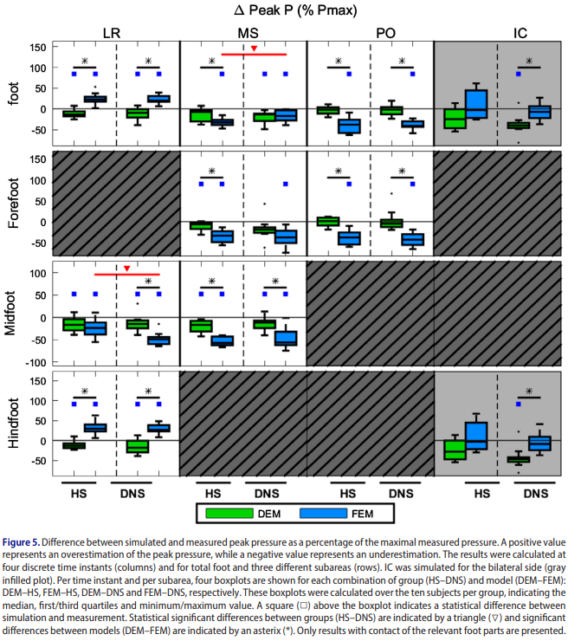
https://limo.libis.be/primo-explore/fulldisplay?docid=LIRIAS2785032&context=L&vid=Lirias&search_scope=Lirias&tab=default_tab&lang=en_US
Multibody dynamics can be used for extraction of plantar pressure data and possibly obtain gait analysis. However, it is not applicable for footwear analysis.
https://doi.org/10.1080/10255842.2017.1372428

Slide 7
Patient Specific Finite Element Analysis
A lot of work for not all that much
Perfect for verification, not for design/ variability

Slide 8
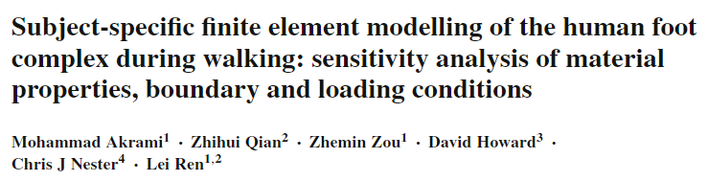
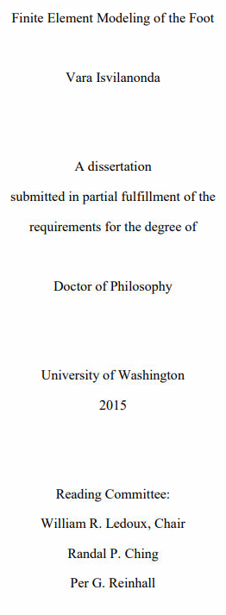
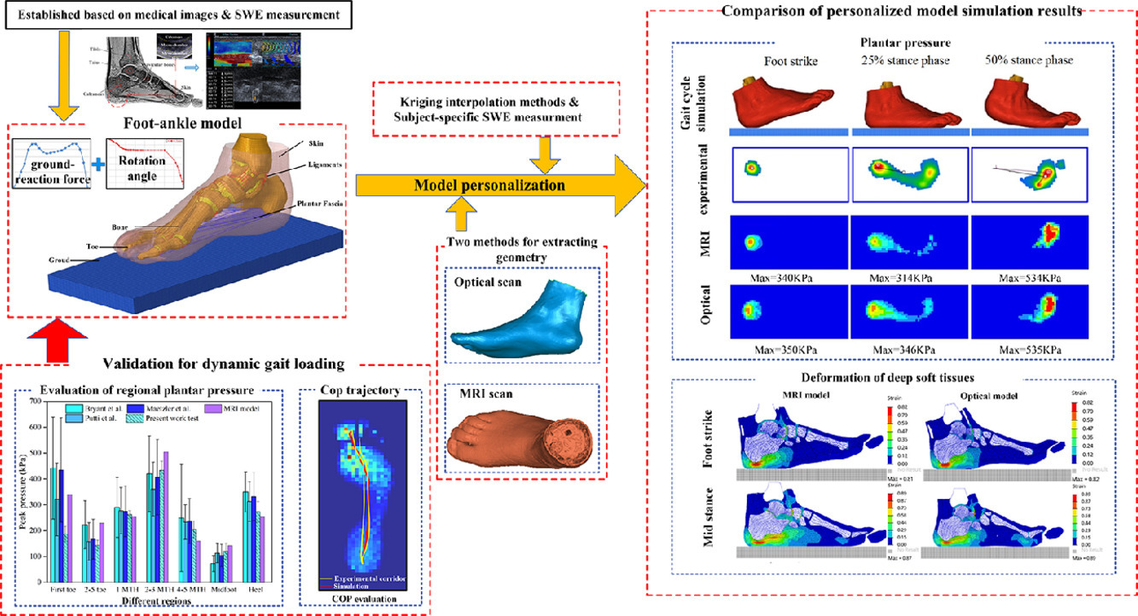
https://doi.org/10.1007/s10237-017-0978-3
High Accuracy
Model creation is very time consuming for every patient
Requires a CT (and preferably MRI)
Segmentation and mesh clean up is not easy
Requires some form of MBD to obtain muscle forces and gait motion
Full gait analysis may not be viable
Finite Element Modeling of the Foot (washington.edu)
https://doi.org/10.1016/j.ijmecsci.2022.107108

Slide 9
Simplified Geometry Finite element analysis
Scope for more…
Combine the previous methods with this for a simple, fast and effective method

Slide 10
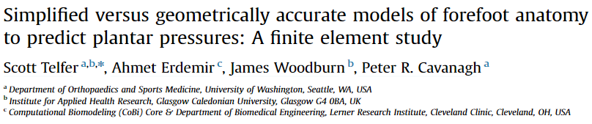
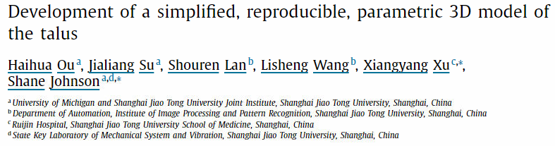
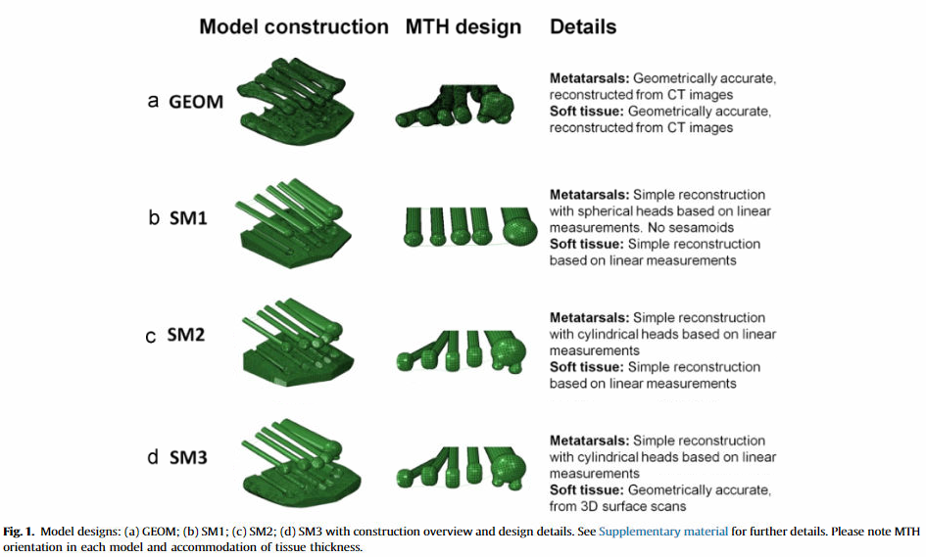
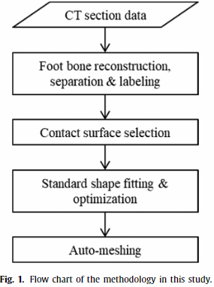
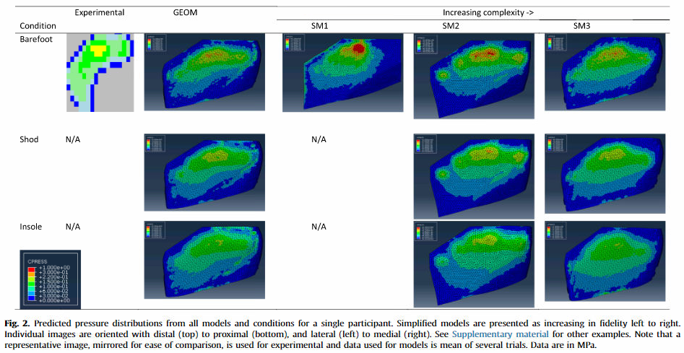
https://doi.org/10.1016/j.medengphy.2019.06.022
https://doi.org/10.1016/j.jbiomech.2015.12.001

Slide 11
THANK YOU

